Slide 1

DEPARTMENT OF COMPUTER SCIENCE AND ENGINEERING
PROFESSIONAL TRAINING 1 PROJECT
JobScrap
PROJECT STUDENTS GUIDE
PRISHA P - 43110658 Ms.DEVI D NEHA -43110651 Associate Professor, CSE

Slide 2
AGENDA
Certificate
Introduction
Abstract
Objective
System Architecture / Ideation Map
Module Implementation
Results and Discussions
Conclusion
References

Slide 3
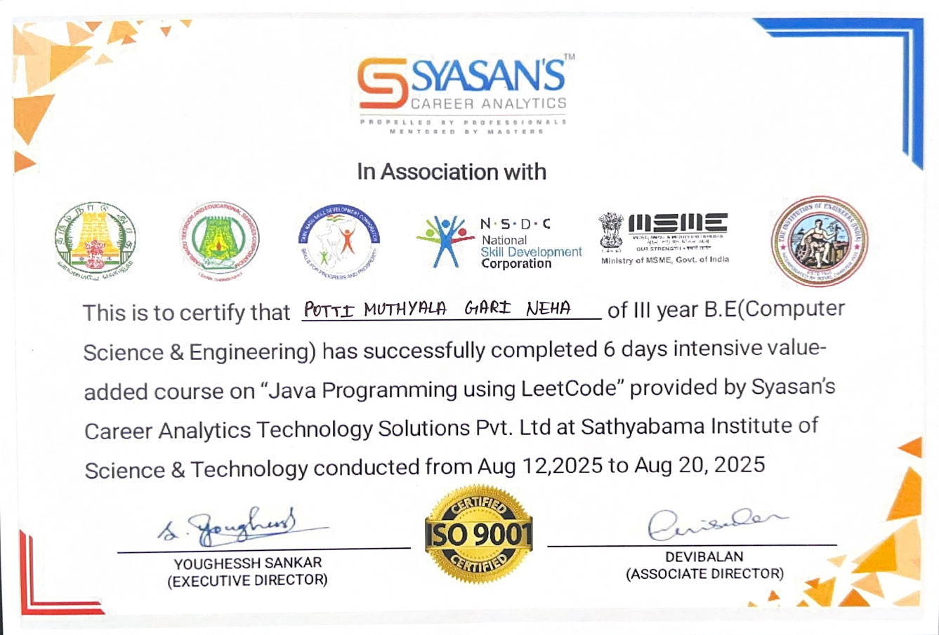
COURSE CERTIFICATE

Slide 4
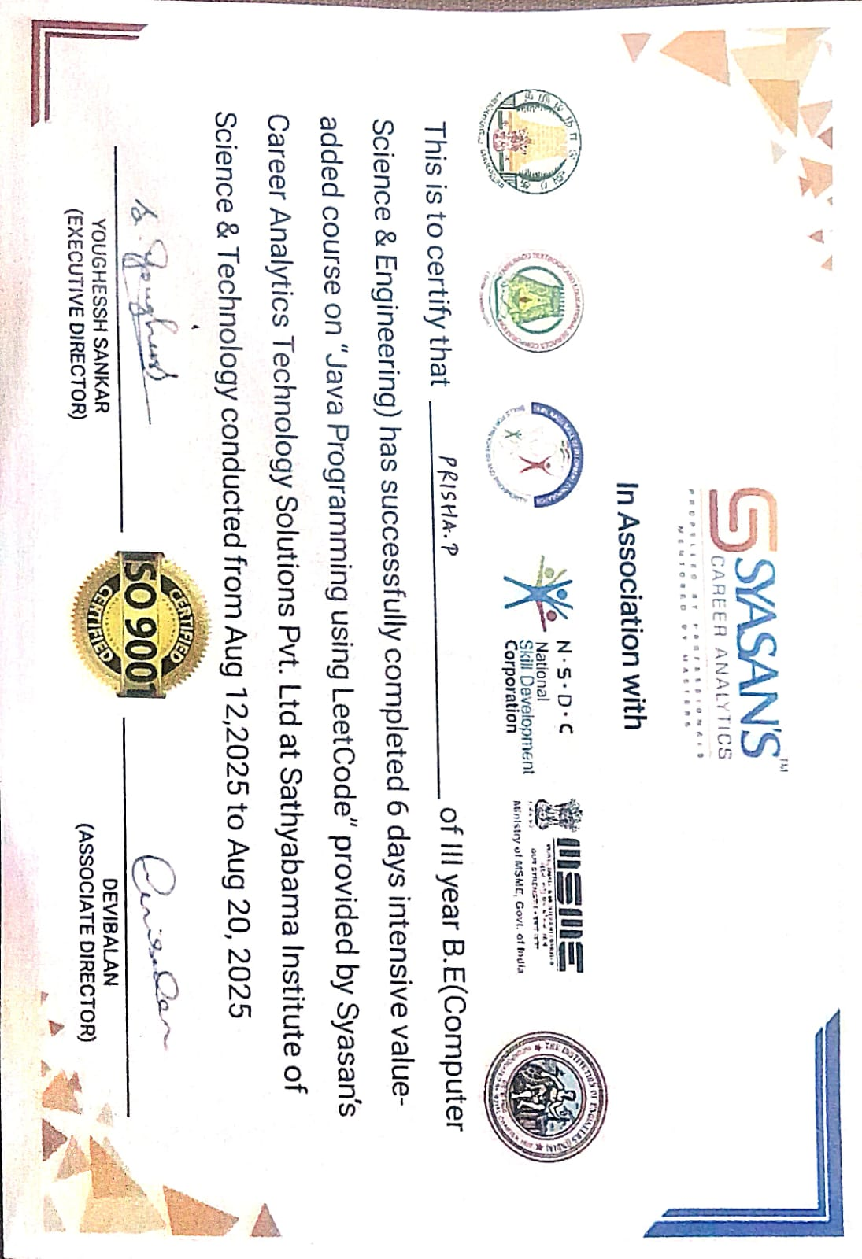
COURSE CERTIFICATE

Slide 5
INTRODUCTION
With the rapid growth of remote work culture, job seekers are overwhelmed by the vast number of portals that host listings. Each platform follows its own structure, making the process of discovering relevant opportunities inefficient. This gap creates a demand for an automated solution that can aggregate, normalize, and present job listings in one place.

Slide 6
Our Job Scraper Application is designed to serve this exact need. Instead of requiring users to visit multiple websites, it collects postings from diverse job boards, unifies them into a common format, and displays them in a clean, searchable interface. Beyond job aggregation, the project demonstrates the integration of web scraping techniques, data storage, and interactive UI design, serving as both a utility tool and a practical implementation of full-stack development concepts.

Slide 7
ABSTRACT
In the modern digital era, remote job opportunities have gained immense popularity due to their flexibility and accessibility.
However, job seekers often struggle with fragmented job postings scattered across various platforms.
Visiting multiple websites, keeping track of updates, and filtering relevant opportunities manually consumes time and effort.

Slide 8
To address this challenge, a Job Scraper Web Application is developed to automate the collection of remote job postings, centralize them into a single platform, and simplify keyword-based search for users.
This project leverages Spring Boot for backend development, H2 database for storing job details, and Thymeleaf for an intuitive frontend. By integrating web scraping techniques, it ensures real-time data updates, thereby reducing the challenges faced by job seekers and making the job-hunting process more efficient.

Slide 9
OBJECTIVE
Aim: To develop a web-based application that automates the collection of remote job postings from multiple online job portals and provides users with a centralized, searchable platform to simplify and enhance the remote job search process.

Slide 10
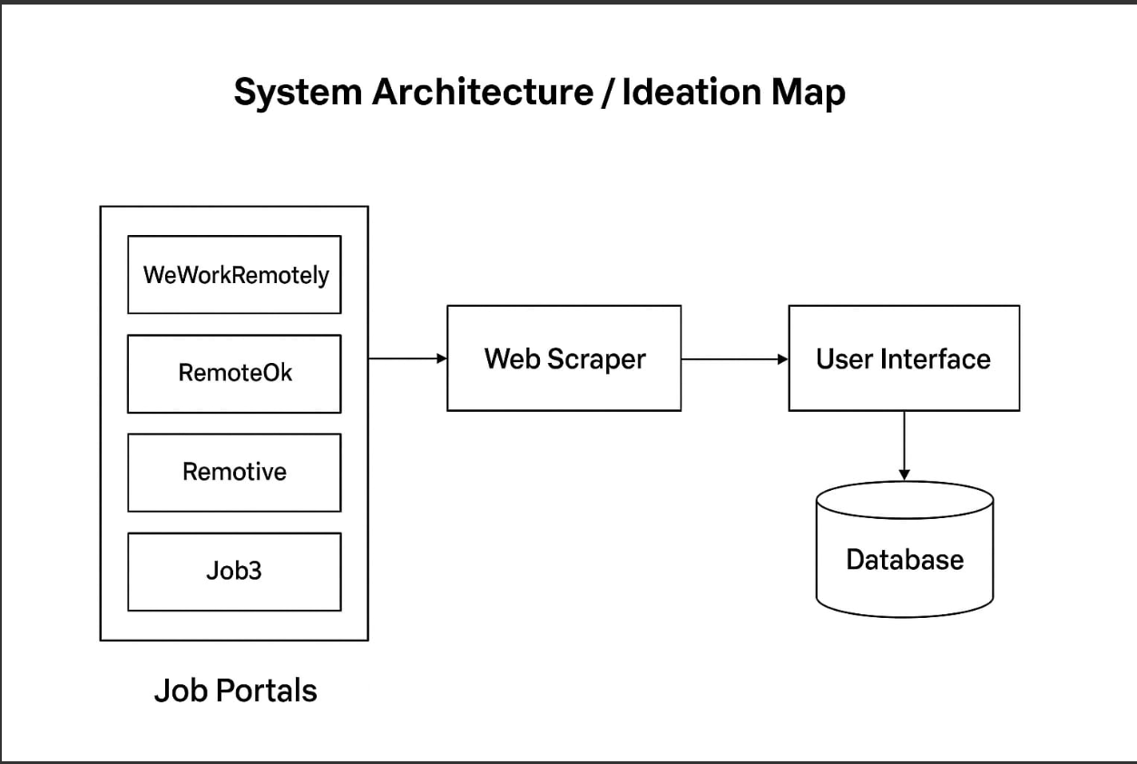
SYSTEM ARCHITECTURE/IDEATION MAP

Slide 11
MODULE IMPLEMENTATION
The project is modular, allowing individual parts to evolve without disrupting the whole system.
Scraper Engines
Each target website has its own scraper class.
Built using Jsoup, responsible for fetching and parsing job listings.
Designed in a plug-and-play fashion to easily add new portals in the future.
Normalization Module
Converts extracted HTML fragments into structured job objects.
Cleans text, formats dates, and ensures uniform fields across portals.

Slide 12
Database Module
Stores jobs in H2 memory database for rapid prototyping.
Supports querying and batch updates.
API Service Module
Implements logic for fetching jobs, applying filters, and serving data.
Acts as a bridge between UI and database.
User Interface Module
Thymeleaf templates connected to Spring Boot controllers.
Styled with HTML/CSS to enhance readability.
Designed for scalability (future improvements: login, favorites, or export).

Slide 13
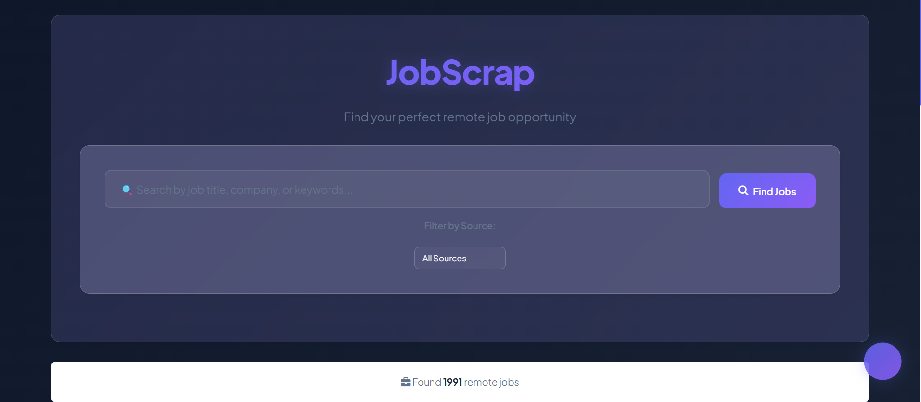
HOME PAGE

Slide 14
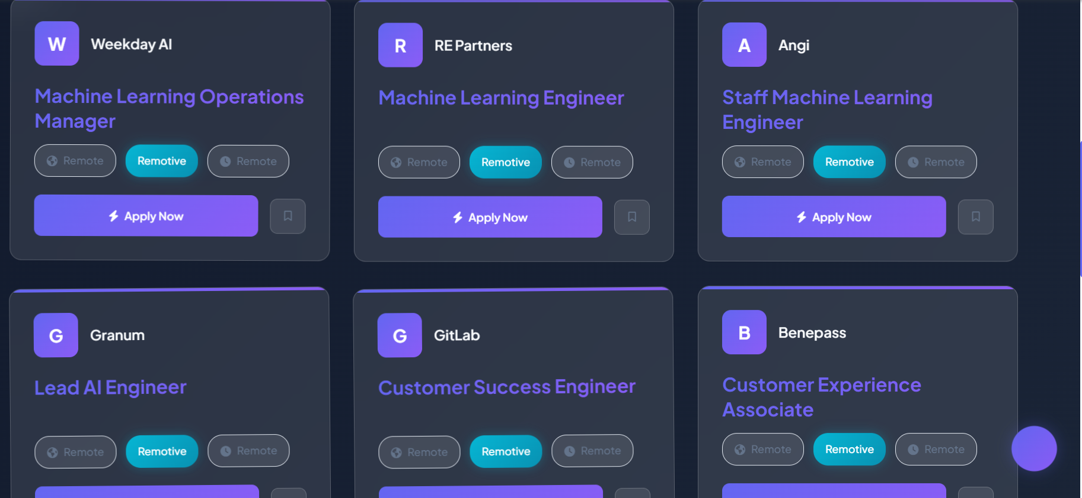
HOME PAGE

Slide 15
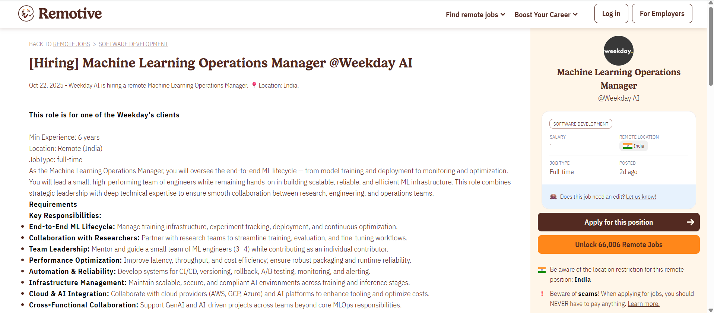
JOB DETAILS PAGE

Slide 16
RESULTS AND DISCUSSIONS
Successfully aggregated remote job postings from WeWorkRemotely, RemoteOk, and Remotive.
Displayed jobs in a user-friendly web interface with search functionality.
Keyword-based search allowed users to filter relevant opportunities.
The system reduced time spent manually visiting multiple websites.
Demonstrated full-stack development skills integrating scraping, storage, and UI.

Slide 17
CONCLUSION
The Job Scraper Web Application effectively solves the challenge of scattered job postings by consolidating data from multiple portals into one centralized system.
With its real-time scraping, keyword filtering, and intuitive interface, the application streamlines the job search process for remote opportunities.

Slide 18
It highlights the practical application of web scraping, full-stack development, and real-time data handling, offering both a learning experience and a useful tool for job seekers.

Slide 19
REFERENCES
Spring Boot Documentation: https://spring.io/projects/spring-boot
Thymeleaf Documentation: https://www.thymeleaf.org/documentation.html
Jsoup Web Scraping Library: https://jsoup.org/
Remote Job Portals – WeWorkRemotely, RemoteOk, Remotive
MDN Web Docs – HTML – https://developer.mozilla.org/en-US/docs/Web/HTML
MDN Web Docs – CSS – https://developer.mozilla.org/en-US/docs/Web/CSS
W3Schools – HTML & CSS Tutorials – https://www.w3schools.com/html/, https://www.w3schools.com/css/
IntelliJ IDEA Documentation ( IDE used)- https://www.jetbrains.com/idea/documentation/

Slide 20
THANK YOU
We thank God, Our Department, Guide, Panel Members, Supportive Professors and all Technical and non Technical staff who helped us in our Project.

